Slide 1

Online Contract
Group members details
Roll No. | Name
3183 | Chauhan Manba
3195 | Kansara Khushi
3226 | Prajapati Bharat
3264 | Solanki Disha
SUBJECT : Cyber law and intellectual property
FACULTY NAME : Moinuddin Quraishi

Slide 2
No | Topic Name
1. | INTRODUCTION OF CONTRACT AND E-CONTRACT
2. | WHAT IS ELECTRONIC SIGNATURE
3. | ESSENTIAL ELEMENT OF E-CONTRACT
4. | PARTIES OF E- CONTRACT
5. | NATURE OF E-CONTRACT
6. | VALIDITY OF E –CONTRACT
7. | FORMATION OF E-CONTRACT
8. | TYPES OF E-CONTRACT
9. | ONLINE STORE AND PRICING MISTAKE (Snapping up)
10. | CASE STUDY
11. | CONLUCTION

Slide 3
Introduction Contract And Online-contract:
Under the Indian Contract Act 1872, the term contract is defined under Section 2(H), which states that an agreement that is enforceable by the law is known as a Contract. In contract, there must be an intent to create legal relationships not social, moral, or religious.
Electronic Contract refers to a contract that takes place through e-commerce, often without the parties meeting each other. It refers to commercial transactions conducted and concluded electronically.
Under the provisions of the Information Technology Act, 2000 particularly Section 10-A, an electronic contract is valid and enforceable.

Slide 4
Contract :
“A contract is an agreement between private parties creating mutual obligation enforceble by law”
The definition of a contract is an agreement between two or more people to do something.
some of the benefits of contracting:-
1.Higher pay
2.improved professional satisfaction
3.greater flexibility

Slide 5
E-contracts:
“Electronic Contract refers to a contract that takes place through e-commerce, often without the parties meeting each other.”
Electronic contracts are the contracts which take place through e-commerce, without meeting of the parties to the contract. These contracts are generally very similar to the paper based commercial contracts in which the commercial transactions conducted and concluded electronically.
Benefits of e-contracting:-
protect contractual partners in electronic environments.
reduce time-to-contract.
reduce process costs.

Slide 6
Electronic Signature:
An electronic signature is defined as "data in electronic form which is attached to or logically associated with other data in electronic form and which is used by the signatory to sign"
When to use an e-signature:-
There’s a good chance you use e-signatures on a regular basis as they’re the preferred signature method for a wide range of purposes. A few common electronic signature examples include:
1.Agreeing to the terms of an online subscription.
2.Signing your e-filed tax return.
3.Including your typed name at the bottom of an email.
4.Using your PIN at an ATM.
5.Signing for charges on a screen at a register.

Slide 7
Benefits of electronic signature:
Electronic signature is reliable. ...
Independent of location and time. ...
Fast and cost-effective. ...
Less paper – an environmentally friendly choice. ...
No scanning – the text remains machine-readable. ...
Method of signing across borders. ...
Several applications.
Example:
a log in using a username and password.
scanning a hand-signed paper document and sending it by email.

Slide 8
According to the United Nations Commission on International Trade Law(UNCITRAL) MODEL LAW on Electronic Signatures, the following technologies are presently in use −
Digital Signature within a public key infrastructure (PKI)
Biometric Device-
Voice Recognition.
Fingerprint Scanning.
Facial Recognition.
PINs
Passwords
Scanned handwritten signature
Signature by Digital Pen
Clickable “OK” or “I Accept” or “I Agree” click boxes

Slide 9
The 2 main parties to an e-contract are:
The Originator and the Addressee.
1. The Originator
An Originator, as per the IT Act, 2008, states that it is a person who sends, generates, stores, or transmits any electronic message to be sent, generated, stored, or transmitted to some other person, and does not, include any Intermediary.
2. The Addressee.
An Addressee, as per the IT Act, 2008, states that it is a person who is intended by the originator, to receive the electronic record, but does not, include any Intermediary.

Slide 10
Nature Of E-Contracts:
The parties do not meet each other physically.
There are no physical boundaries set.
No handwritten signature is needed. It should be an electronic agent.
Since there is no full security, the risk factor is very high in such contracts.
Jurisdictional issues are a great setback on e-contracts in case of any sort of breach.
There is no single authority to look into the whole process exclusively in shrink-wrap contracts.
Digital Signatures and electronic records are used as evidence when any case arises in court.

Slide 11
Essentials of online contract
The essentials of Online Contracts are almost the same as the essentials of a valid contract like:
Valid Offer
It is essential to have a valid offer for a contract to come into existence. It is important to note that the items displayed in any e-shopping app are only an invitation to offer and not an offer in itself. There is an offer when the person selects a particular item into the cart or gives an order.
2. An offer needs to be acknowledged with legal consideration
It is important that the offer has to be accepted. Acceptance should reach the offeror by any method. (Mail,
message etc.). The offer is revocable until the acceptance is made. consideration given from the party should be legal to have a valid e-contract. For example, selling narcotic drugs or pornography is strictly prohibited and cannot be considered as valid consideration.
3. Parties must be able to contract with each other
In online contracts as there is no real-time connection, it is important to note that there should be a confirmation that both the parties are humans as computers are not able to enter into a contract. This is a very important part of an e-contract and one should be careful as cases of cyberbullying and online fraud are increasing.

Slide 12
Continue in elements…
4. Free consent
Consent should always be free. Consent is said to be free when it is not caused by coercion, misrepresentation, undue influence, or fraud.
When it is certain that these above-mentioned elements are present, only then an e-contract is confirmed. Along with these elements, a contract is only possible when there are a lawful object and possibility of performance’.
5. Lawful Object
The object of the contract should be lawful. Any contract where the object is against the public policies, the contract will be void and illegal.
6. Competent parties
The parties to the contract must be competent to make a contract with each other. The party should not minor, unsound mind and be forbidden by law to make the contract.
7. Certainty of Terms
There must be the certainty of terms and conditions between both parties.

Slide 13
Validity Of E-Contract:
Under the provisions, of the Information Technology Act, 2000, (IT Act, 2000) mainly Section 10-A, it says that an electronic contract is valid and enforceable.
In India, the Indian Contract Act, 1872 governs all agreements and contracts, including online contracts. The fundamental essentials of a valid contract are addressed in Section 10 of the Indian Contract Act:
A party offer and the other party’s acceptance.
Mutual agreement among the Parties.
Intense legal relationship building.
Contracting parties should be legally able, i.e. be over the age of 18 years, have the soundness of mind, solvent etc.
The purpose of the contact is legal and is not contrary to government policy, e.g. a prohibited drug’s sales agreement is not a valid contract.
The agreement should be supported by means of cash or in any kind i.e. consideration
The agreement should be capable of being performed.
The contract terms are sure.

Slide 14
Case on validity of Online Contract
Trimex International FZE Limited, Dubai vs. Vendata Aluminium Ltd.:
In this case law the parties agreed on all the terms and legally entered into a contract through emails. The Supreme Court held the contract valid as the contract was entered through proper consent, there was a intention to create legal relationships and was followed by due procedure of law. The court did not annul the contract because it was through email.
This shows that the contracts through email and other online mode can also be valid if all the essentials to a contract are satisfied. Thos also shows the validity of the communication through online mode in the Indian courts.

Slide 15
Types Of E-contract:
E-Contracts Can Mainly Be Of Three Types:
Click-Wrap Agreements
Browse-Wrap Agreement
Shrink-Wrap Agreement
Other types of online agreements include contracts for consultants, employees, contractors, sales and resale agreements, distributors, software developer and licensing agreements, and contracts for source-code escrow.

Slide 16
1. Click wrap contract
Clickwrap contracts refer to those familiar and long blocks of text that nobody reads, detailing the terms and conditions for using a web-based service, software, etc.
They’re called clickwrap contracts because the user typically has to click a button or check a box to indicate that they accept the contract.
If the customer/client wants to avail of the service, he shall click on “I accept” or “I agree” or “Ok”. Similarly, if he wants to reject the service then he can simply click “Cancel” or close the window directly.
This agreement is discovered as part of the installation process of software packages and is also known as a “click-through agreement” or “take-it-or-leave-it” Because there user has only two options they can agree or reject it.
Ex.when we visit any websites first time or install any app/software Then we see a pop-up appear on the display containing the terms and conditions and an "I agree" button. If you wish to use the Service you must agree to those terms and conditions otherwise you may not use it.

Slide 17
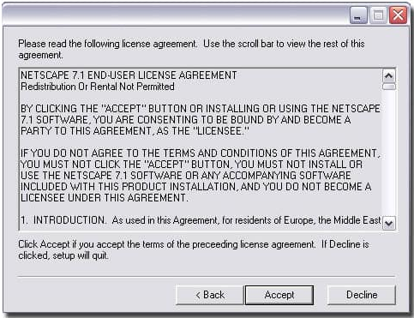
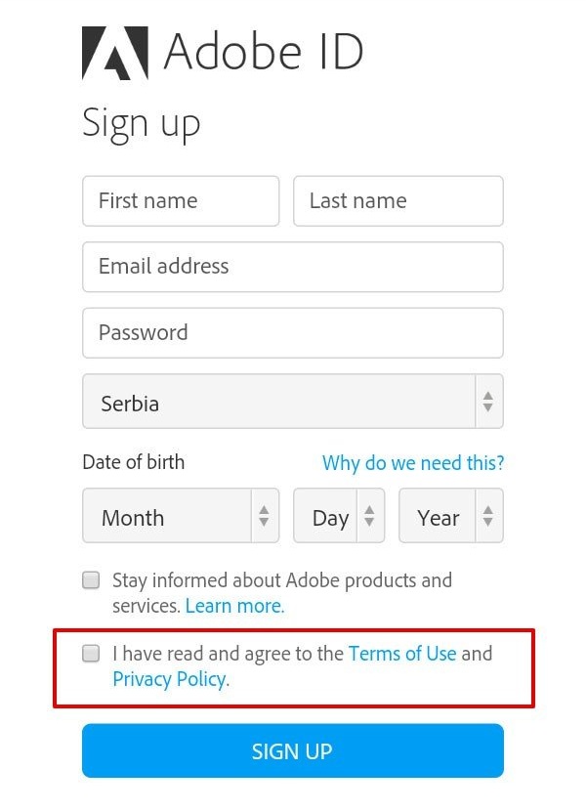
Examples of click wrap contract-

Slide 18
2. Browse wrap contract
A browse wrap agreement is intended to be binding on the contracting party by the use of the website.
In Browse Wrap agreements, a hyperlink is mentioned on the website which contains the terms and conditions regarding the usage of the website. These terms and conditions generally claim that by the usage of the website, the person has voluntarily consented to be bound by the terms and conditions mentioned.
For example, e-commerce websites such as Amazon, Flipkart, Myntra, Snapdeal, etc, display a hyperlink on their websites under the tab of “Terms and conditions” or “Terms of Use”.
By clicking the hyperlink, it directs the client/customer to a page displaying the terms and conditions in detail. These terms and conditions contain a precise statement, stating that by accessing, browsing, or using the website, the client/customer indicates his consent to all the terms and conditions of the website.

Slide 19
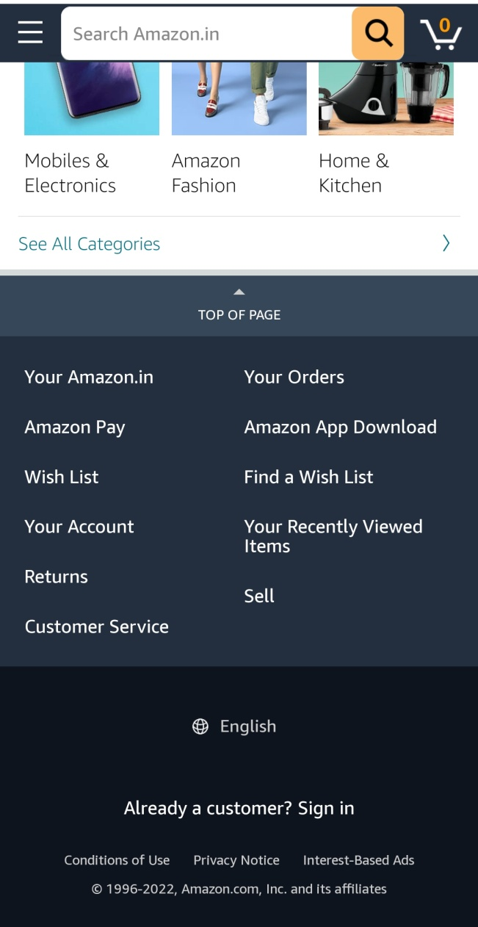
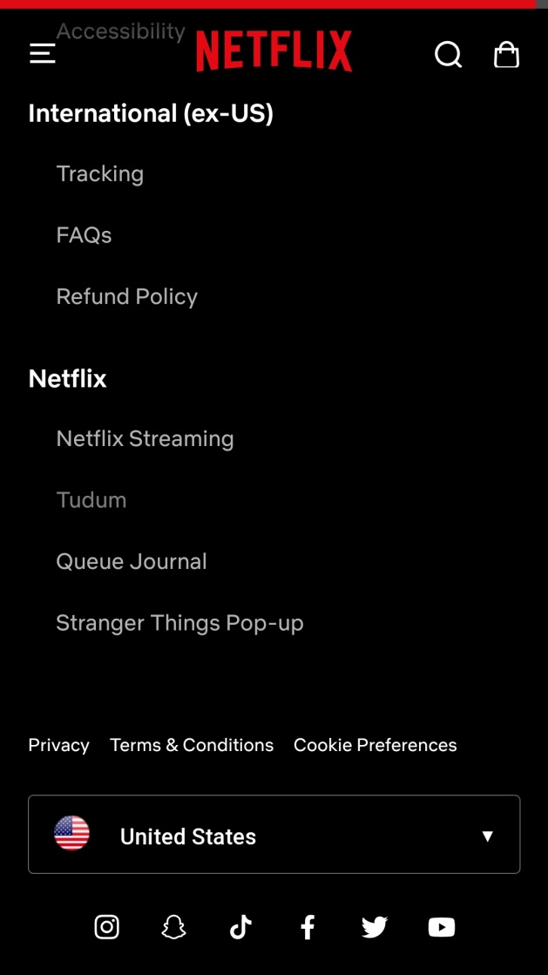
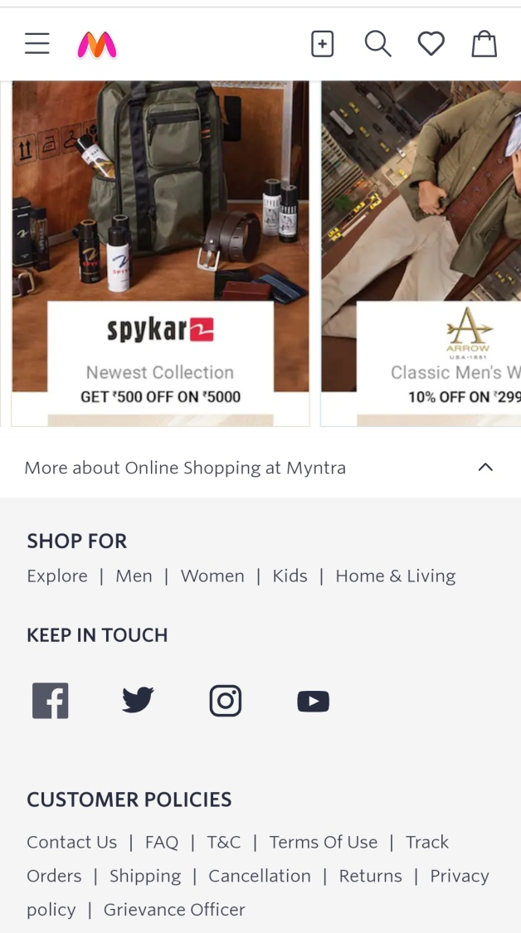
Examples of Browse wrap contract:

Slide 20
3. Shrink wrap contract
Shrink-wrap contracts are typically licensing agreements for software.
Shrink wrap contracts are contracts packaged with products. By using the product you are agreed that contract.
The Shrink Wrap Agreement is similar to the Click Wrap Agreement except that it is a physical document.
The name derives from the shrink wrap packaging of the CD-ROMs in which software used to be distributed. In cases when licensing contracts are packaged along with the software, the contract begins when the user tears open the shrink wrap to use the software.
Licensing agreements these days are usually not delivered with the packaging and instead show up before installing the software in question.
Shrink wrap contracts, as we shall see, have a decided advantage over other types of electronic contracts in that their acceptance can be reversed by returning the product.
An example of a shrink-wrap agreement is an End User License Agreement (EULA).

Slide 21
Online store & pricing mistakes(Snapping up):
The case whereperson, realisingthe mistake of the other, gets into a contract to take advantage of the mistake is known as “snapping up”.
The essence of snapping up is in taking advantage of a known or prerceived error.
In the case of snapping-up, the law takes it that there is no agreement (meeting of minds), as the parties have different things in their minds. Thus, a snapping-up contract is void and not binding on the parties.
Chwee kin keong v. digilandmanll.com Pte Ltd from the singapore High court is a leading case on the snapping Up.

Slide 22
Case on Snapping up:
Chwee kin keong v. Digilandmall.com Pte Ltd.
Facts:The defendant, Digilandmall.com Pte Ltd, were an online IT company that sold related software and hardware from Singapore. They were selling a HP laser printer and an employee accidently made a mistake as to the price of the printer on their website. It was listed at the price of $66, when it was advertised on the official HP website for $3,854. This was not noticed by the company until over 4,000 printers were ordered. The complainants had ordered over 100 printers each at this price. When the defendants discovered this mistake on their website, they sent an email to the complainants to say they would not be fulfilling this order.
Issues:The complainants argued that they were not aware that this price was a mistake and wanted the binding contract to be fulfilled. The defendants argued this pricing was a unilateral mistake and that the complainants took advantage of this. The issue in this case was whether the pricing was a mistake and if the contract would be fulfilled.
Decision/Outcome:It was held that the contract between the parties was void. This pricing was a mistake, which was fundamental to the contract and the complainants must have known that this ‘absurdly low’ pricing was an error by the defendants. In this case, there was no meeting of the minds between the parties, which meant that there could be no binding contract between them.

Slide 23
Formation of E-Contracts
The e-contract is also consisting an offer and acceptance. Also, it is enforceable by law. The e-contract is formed online. There are some common procedures that are used for the formation of E-Contracts:
End-User License Agreements(EULA):
It happens many times that we click on “I accept” or “I accept the terms and conditions” to install software or anything while using the electronic device. It is a valid form of contract because we are accepting the proposal of the company online.
Emails:
The parties may create a valid contract by exchanging e-mail communications. Offers or acceptances can be completely exchanged via e-mail, or combined with paper documents, faxes, and oral debates.
Websites forms:
When we use the e-commerce website to purchase the online product, we will the order form where we mention our name and how many quantities of the product we want. This form is an e-contract. We fill the form and place the order. Now the order will be delivered to the address given by us.

Slide 24
Case Study:
Case Name: P.R. Transport Agency vs. Union of India & others
Facts:
In this case, an e-auction was held by Bharat Coking Coal, (here it is referred to as BCC for the allocation of coal. BCC accepted the bid of P.R. Transport Agency) ( referred to as PRTA) for 4000 metric tons of coal at Rs. 1,625/- per metric tons from Dobari Colliery.
On 19th July the acceptance letter of the bid was sent via e-mail to PRTransport Agency's e-mail address. A sum of Rs. 81.12 Lakhs was deposited by PRTA to the cheque drawn in favor of BCC in terms of ‘Terms of Allocation'. PRTA anyways accepted the cheque but failed to deliver the coal.
An e-mail was sent by BCC for canceling the cheque deposited by PRTA because, of technical issues and unavoidable reasons. However, the actual reason was something different. It was that some other person's bid was higher than that of PRTA. The higher bid was not taken into consideration due to a flaw in the software. PRTA went to the Hon'ble High Court of Allahabad, aggrieved by this letter.
Decision:
The Court, based on Section 13(3) of the IT Act, held that the acceptance of tender by e-mail would be deemed to have been received by the petitioner at Varanasi or Chandauli, which are the only two places where the petitioner has his place of business. As both these places fell within the territorial jurisdiction of the Allahabad High Court, the Court assumed the jurisdiction to try the dispute.

Slide 25
Conclusion
After knowing about the validity of the online contracts in Indian context and the key essentials to form an online contract, we can conclude that there are not many cases which talk about the contracts formed through online mode. It is still debatable as to when email contracts are concluded and are binding. Yet when we read Indian Contract Act, 1872 with the Information technology act, 2000, we get to know that these define the online contracts and contracts through emails.
Also in the Covid times, where everyone is shifting to online mode there is a need to bring a separate legislation in India so as to bring better validity to the contracts and make them legally binding. It should also be made more protective so that people could rely more on these modes of communication by legal status to the concept of digital signature. When the social distancing has become the norm for life, there is a need to make ratify the international conventions and a make a more reliable law for India in response to the online contracts and contracts made through email.

Slide 26
Conclusion continue….
It is quintessential that the administration keeps an eye on these as development and technological advancement never stops. There are problems of continuous monitoring and authentication when it comes to E contracts. Along with these the problem of solving disputes arises as a non-complimenting party should perform corrective action. There are many other problems like this and government has to be vigilant and responsive as the application of e-contract will only increase in the future.

